Slide 1
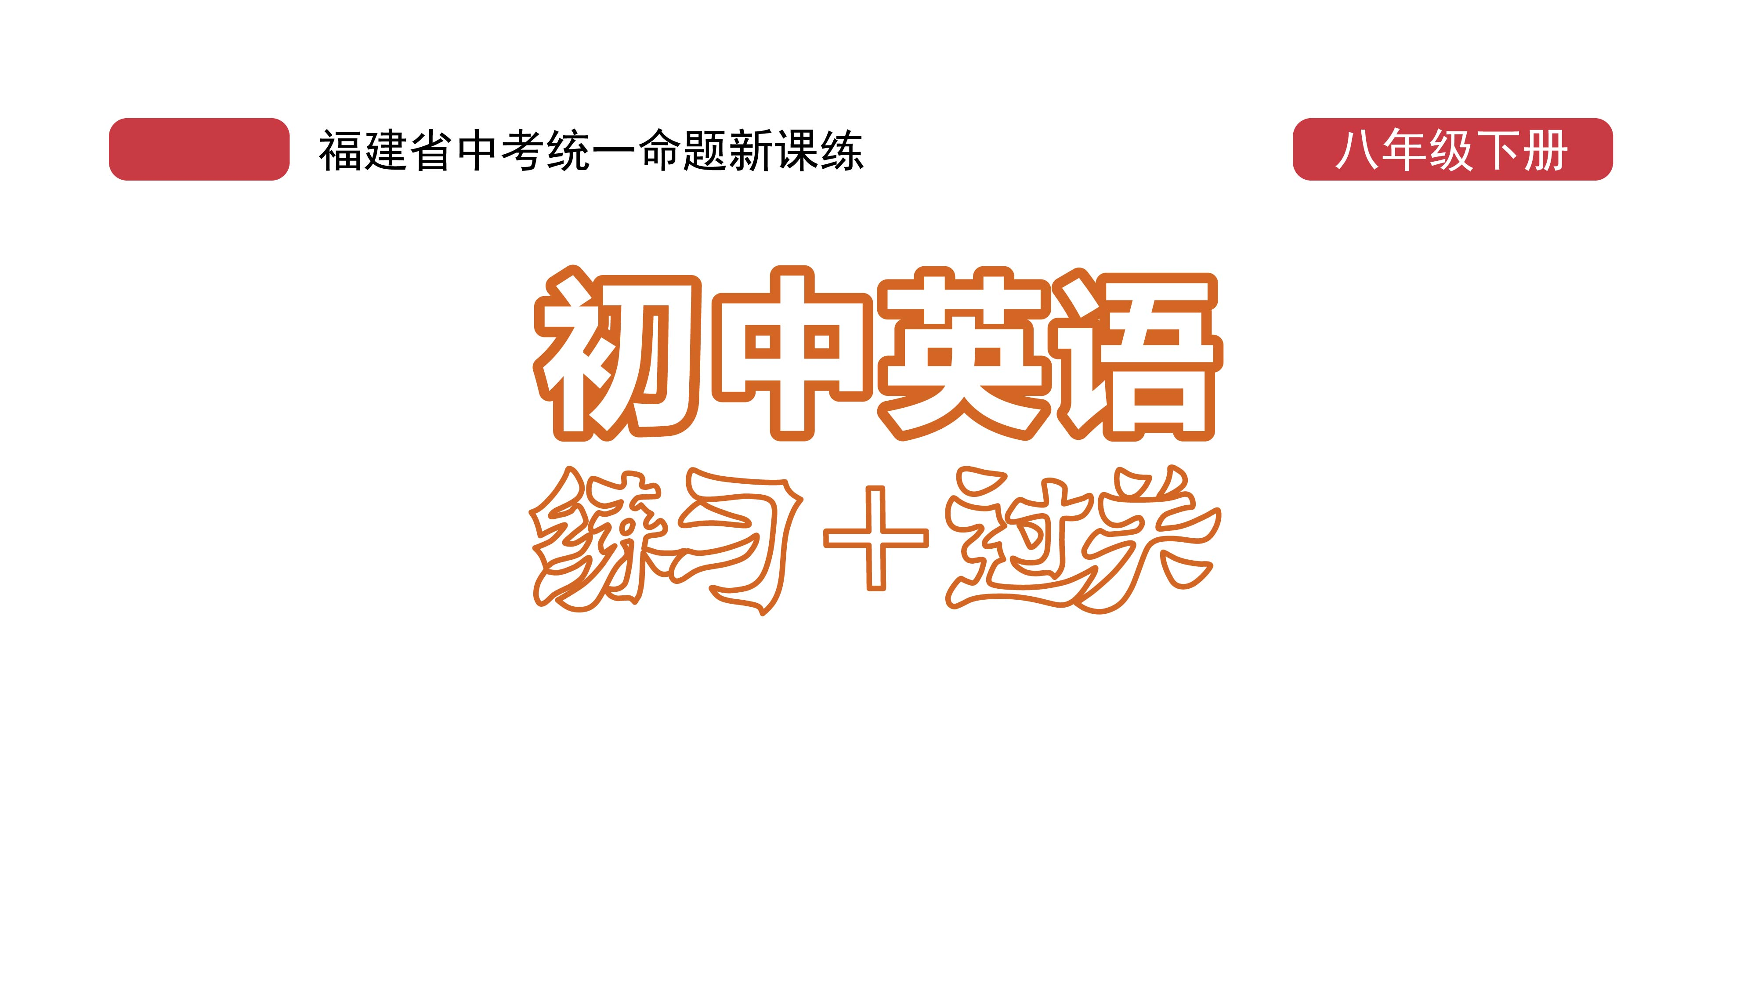
过关测试卷
模块八 第一章 测试卷

Slide 2
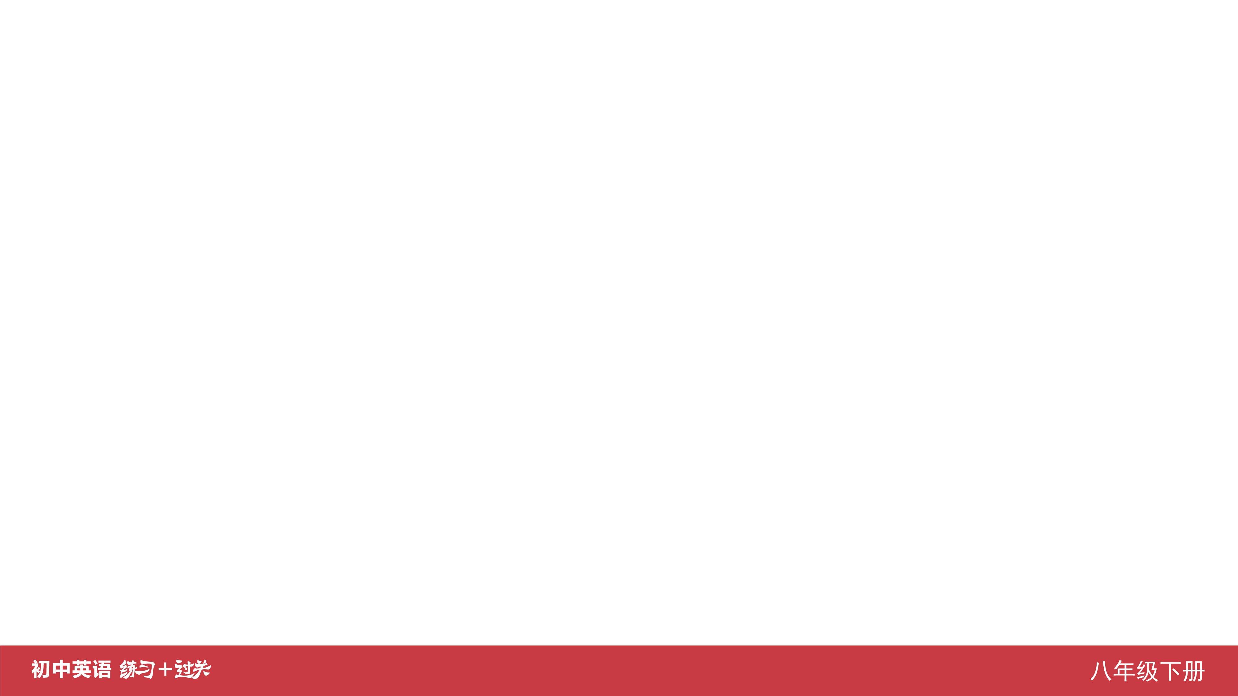
Ⅰ. 听力
1-5 ____________
6-10 ____________
11-15 ____________
16 ____________
17 ____________
18 ____________
19 ____________
20 ____________
BBACA
BCAAB
CCBBC
English
100,000
international
Tying
songs

Slide 3
Ⅱ. 选择填空
21-25 ____________
26-30 ____________
31-35 ____________
BCCAB
CCBBC
BCCAC

Slide 4
Ⅲ. 完形填空
36-40 ____________
41-45 ____________
CAACB
BCACB

Slide 5
Ⅳ. 阅读理解
46-50 ____________
51-55 ____________
56-60 ____________
61-65 ____________
66-70 ____________
CBCAC
CACBC
CACDB
BDBAC
BACDE

Slide 6
Ⅴ. 情景交际
71. __________________________________________
__________________________________________
72. __________________________________________ __________________________________________
73. __________________________________________
__________________________________________
Shall we meet at my house/home at 3:00 p.m./this afternoon?
How do you like this dress?/
What do you think of the dress?
Excuse me, could you tell me where to buy a jacket/where I can buy a jacket?

Slide 7
Ⅴ. 情景交际
74. ________________________________
________________________________
75. ________________________________ ________________________________
Does your business go well?/
How is your business going?
How much is this pair of shoes?/
How much are the shoes?

Slide 8
Ⅵ. 看图写话
76. ____________________________________________
77. ____________________________________________
____________________________________________
78. ____________________________________________
____________________________________________
The desk is made of wood.
It is such a nice dress that the girl/she looks (very) beautiful (in it).
People can wear a sweater to keep warm./
Wearing a sweater will keep you warm.

Slide 9
Ⅵ. 看图写话
79. ____________________________________________
80. ____________________________________________
____________________________________________
____________________________________________
The man/He succeeded in catching a fish.
Sunglasses can protect your eyes from the sun./
People wear sunglasses to protect their eyes from the sun.

Slide 10
Ⅶ. 短文填空
doing
environment
national
but
how
81 ____________
82 ____________
83 ____________
84 ____________
85 ____________
86 ____________
87 ____________
88 ____________
89 ____________
90 ____________
money
like
dangerous
longer
feels

Slide 11
Ⅷ. 书面表达
Sunday, May 16thSunny
Last Sunday, I went shopping with my mother.
First, we went to the Women’s Wear Section. My mother saw a beautiful scarf there. She liked it so much that she bought it. Then, we went to the Men’s Wear Section. My mother chose a cotton windbreaker for me. It made me look more handsome. After that, we went to the Shoes and Hats Section. There we bought a pair of leather shoes for my father. We were sure my father would look important in the shoes.
When we went back home we were tired, but we were very happy.

Slide 12
